Slide 1

Don’t mess with the Rombertik

Slide 2

How do you get infected?
Phishing
Attracts targets through email propositions
Program disguised as document but really is a .SCR
Compromises data after launching it

Slide 3
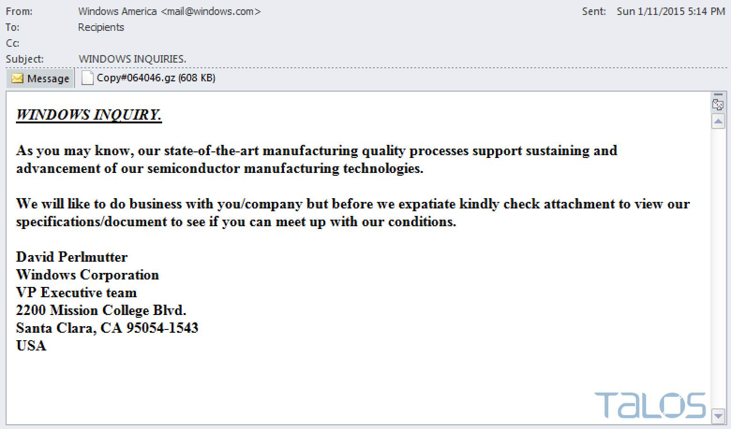
Email recovered by Talos

Slide 4
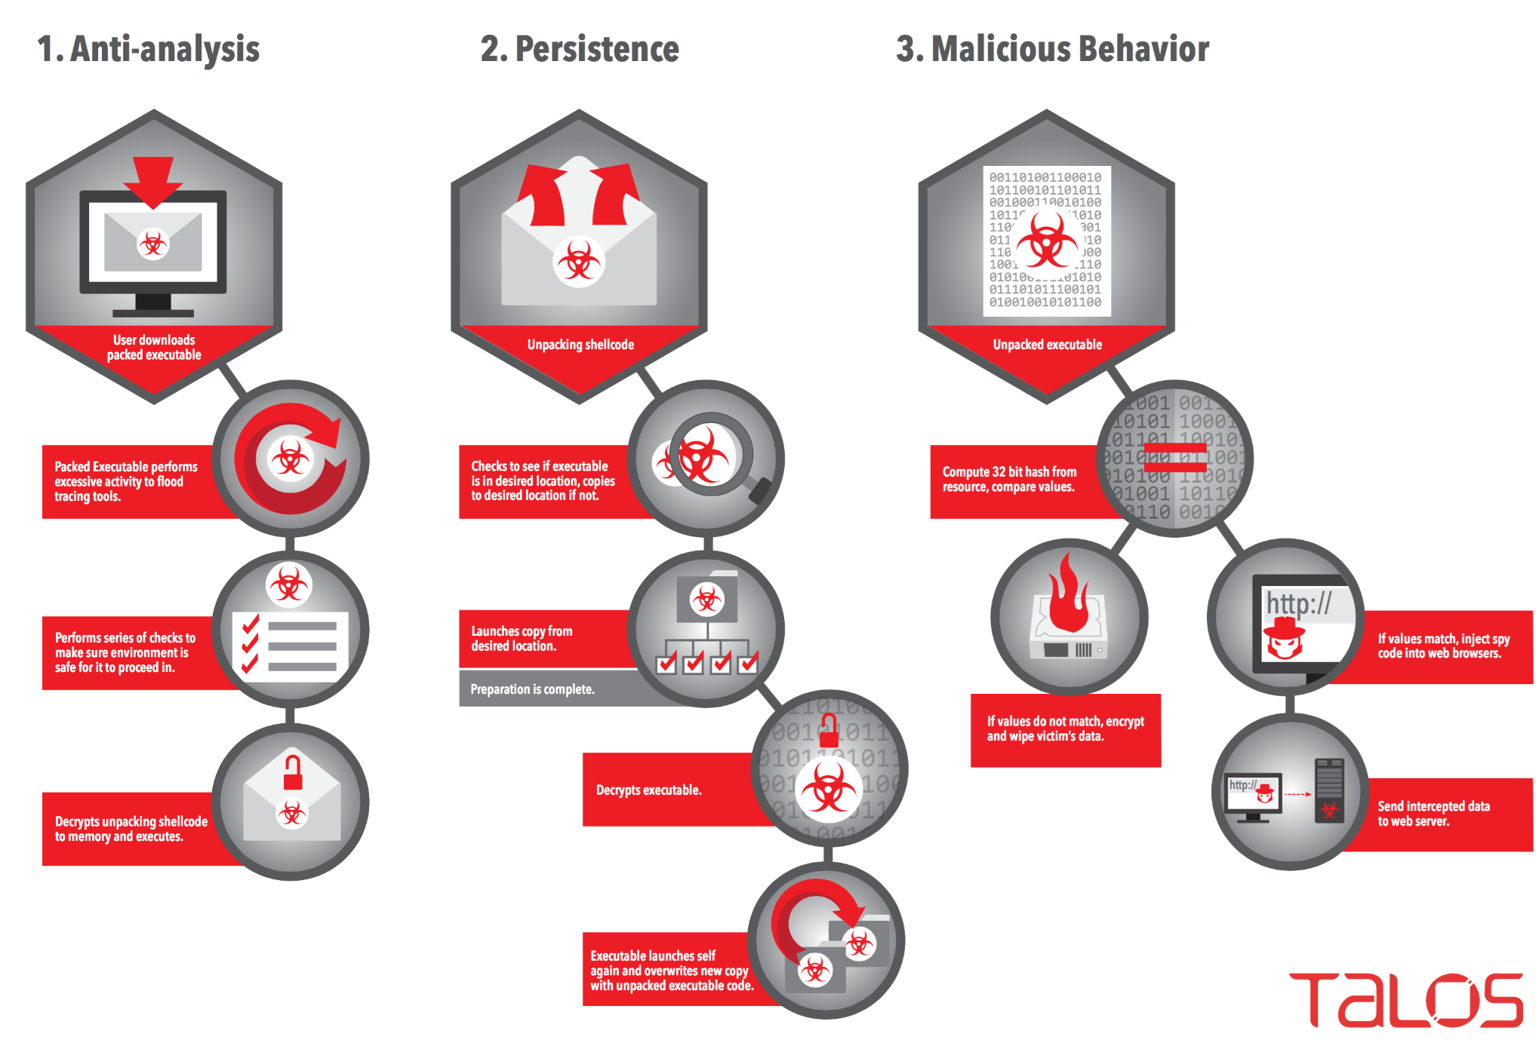
Compromise flow of Rombertik

Slide 5
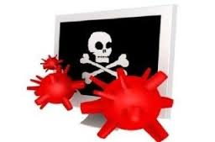
What is it?
50% Blastware
50% Spyware
First comes Blastware then comes Spyware

Slide 6
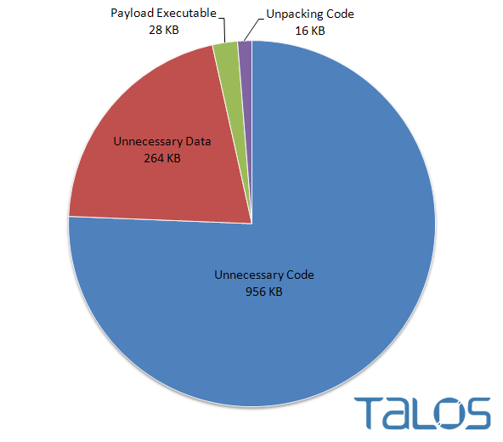
Anti-analysis Code
Majority of the file is garbage Code

Slide 7
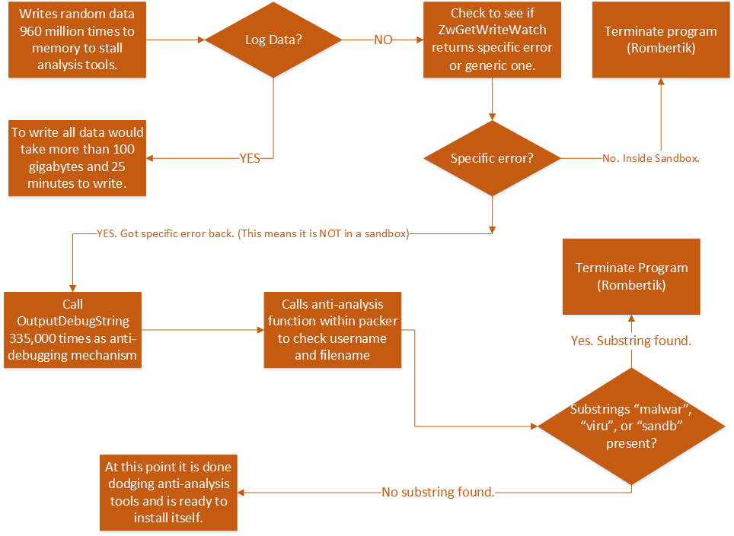
Anti-Analysis Evasion Process

Slide 8
Extraction Process
Rombertik creates and moves itself from (%AppData%\rsr\yfoye.bat) into
(%AppData%\rsr\yfoye.exe)
Executes yfoye.exe to unpack itself
Unpacked code overwrites previous code in memory
Unpacking Process
Unpacking process is much larger than Anti-analysis process for more complexity

Slide 9
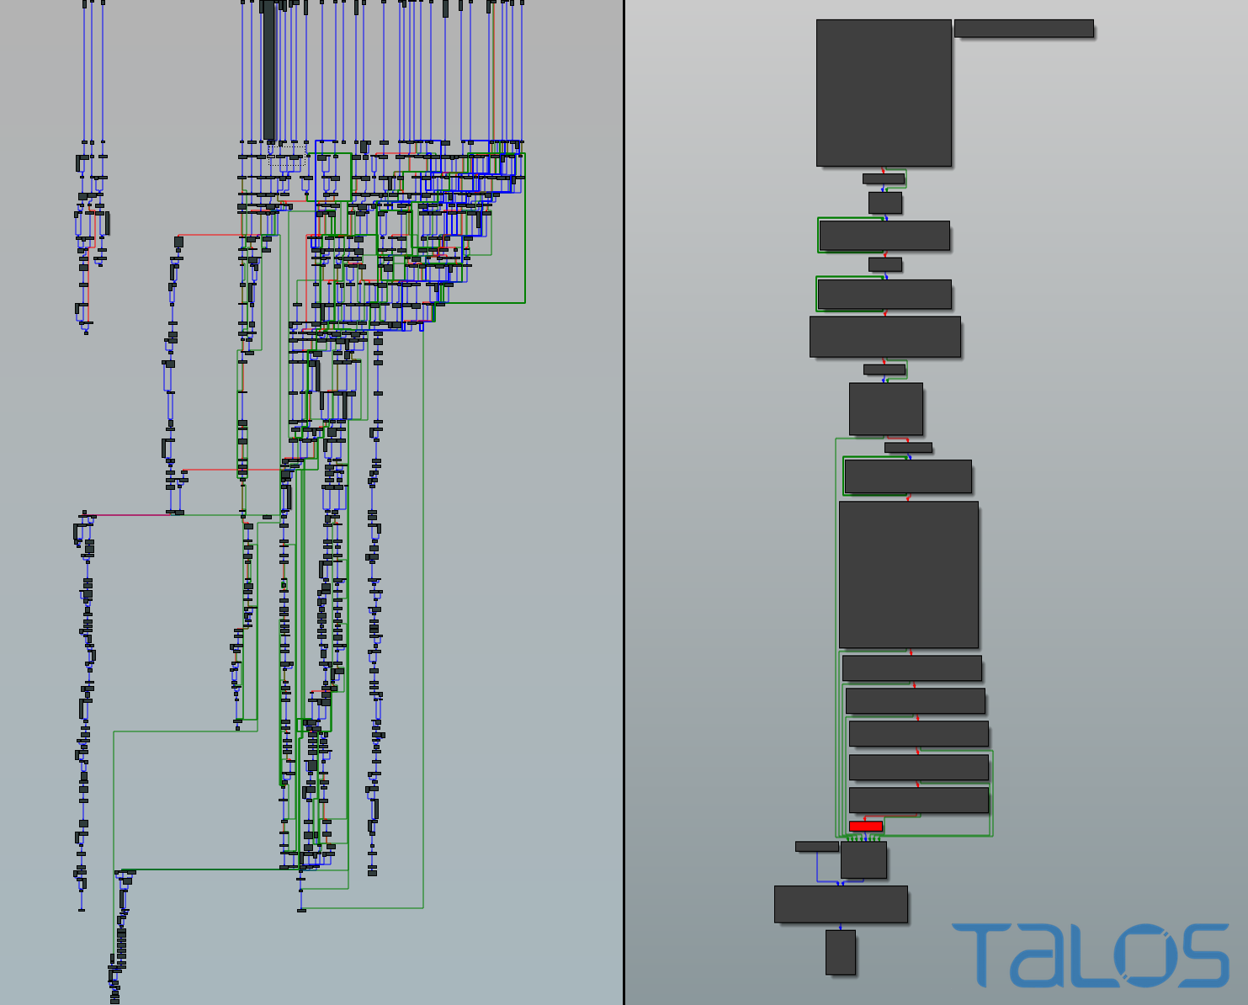
Unpacking process on left, Anti-analysis on right

Slide 10

What it does
Spyware
Captures data sent over https
Encrypts data then sends to www.centozos.org.lin/don1/gate.php

Slide 11

Blastware
Destroys OS when detected
Destroys user home files if destroying OS fails

Slide 12
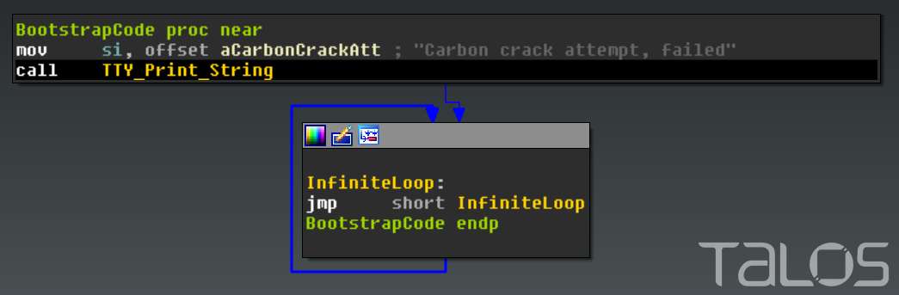
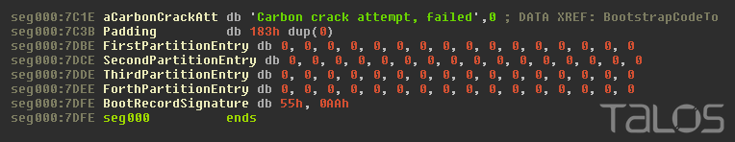
Blastware
Overwriting Boostrap execution code
Overwriting MBR disk partitions

Slide 13
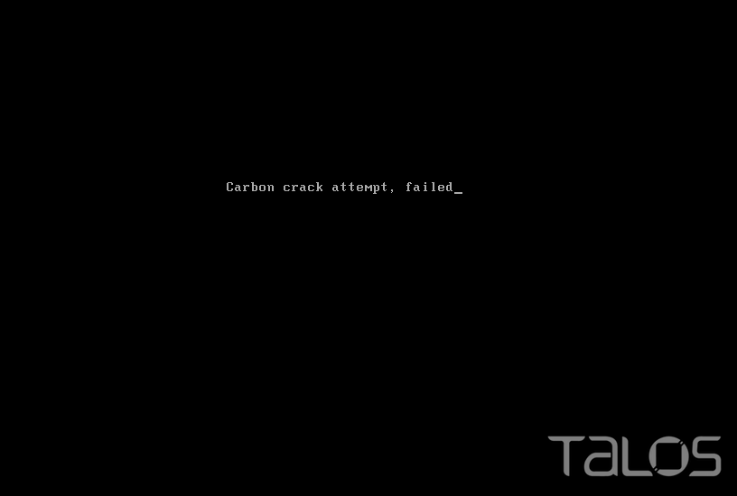
Attempting hackers receive this message when they fail to change the C&C address

Slide 14
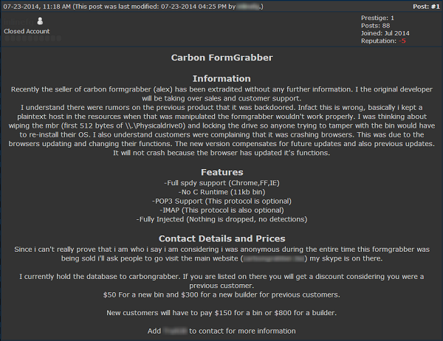
What Rombertik really is
Modified version of FormGrabber
Made by commercial criminal enterprise
Made for looser cybercriminals who don’t know how to program
Developed specific to each client Command & Control server
Destructive mechanism originally made for anti-piracy

